Slide 1
Route Optimization
Project Mentor: Ramesh Eswar L
Batch 17

Slide 2





Business Problem
Spring Cleaning
Residential and Commercial Cleaning
Travel Time + Vehicles = Money (Expense)

Slide 3
Objectives
Find ideal range of stops per route/vehicle
Minimize - Total trip time
Minimize – Total number of vehicles used

Slide 4






Data
Service Time Table
Travel Time Table
Stop ID
From Stop ID
Service Time (Minutes)
To Stop ID
Early Slot Time (11 AM)
Travel Time (Minutes)
Late Slot Time (2 PM)

Slide 5
Input Parameters
Min Stops Per Route/Vehicle
Max Stops Per Route/Vehicle
Max Trip Time(660 mins)
Early Time Window(30 or 60 mins)
Late Time Window(30 or 60 mins)

Slide 6
Observations
189 stops and 6 depots
Service time
Min. 1st Qu. Median Mean 3rd Qu Max.
15.0 30.0 45.0 58.17 75.0 285

Slide 7
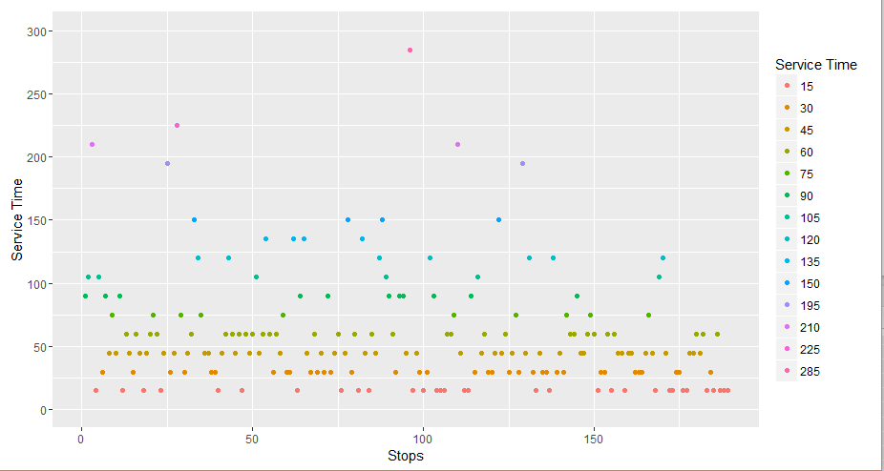
Observations

Slide 8

MDVRP with Time Windows
15 Mins
45 Mins
25 Mins
263 Mins
225 Mins
300 Mins
20 Mins
Depot
55 Mins
55 Mins
55 Mins
Depot
55 Mins

Slide 9
Critical Business Conditions
Total Trip Time Per Route <=660 mins
Try to fit as many customers possible within the time slot (11AM-2PM)
Every route should have stops within min-max stops threshold.
Penalize every route with some percentage of travel time when any of the above conditions are not met.
All trips should start and stop at the same depot.
Each customer should be visited exactly once.
All the orders for the day should be serviced.
Trip Time= Travel Time + Service Time

Slide 10
Assumptions
To calculate cost of the solution, we fix 1$ per min of travel and 100$ per route/vehicle as fixed cost.
We receive all the orders one day in advance.
There is enough number of vehicles available in every depot
First customer on a route is always visited at 10:30(Early Slot Time - Early Time Window)

Slide 11
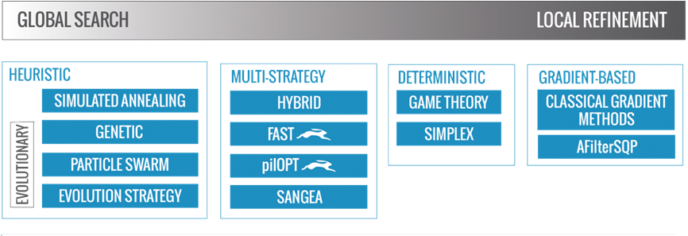
Optimization Taxonomy
https://goo.gl/dxrbEP

Slide 12
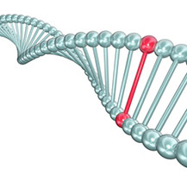

Heuristic Approach Inspired Based On Genetic Algorithm
Terminologies
Gene = Stop ID
Chromosome = Set of routes covering all the stops under a depot
Population = Set of solutions of a depot
Mating Procedures
Cross Over
Mutation

Slide 13
Flow chart : Genetic Algorithms
Start
Randomly generate initial population
Evaluate all individuals
Satisfy
Stop
Criterion
Yes
Generation cycle
Best Individuals
No
Selective Reproduction
Result
Cross-over
Mutation

Slide 14
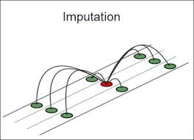
Preprocessing
Handling Missing Values
The most commonly used central imputation does not work here as it is an optimization problem. we have to consider the worst case scenario to achieve minimum time and distance travelled.
 | Stop 1 | Stop 2 | Stop 3 | Stop 4
Stop 1 | 0 | 118 | 220 | 300
Stop 2 | 110 | 0 | 400 | 60
Stop 3 | 225 | NA | 0 | 49
Stop 4 | 315 | 57 | NA | 0
NA = Column Max(Stop 2)

Slide 15
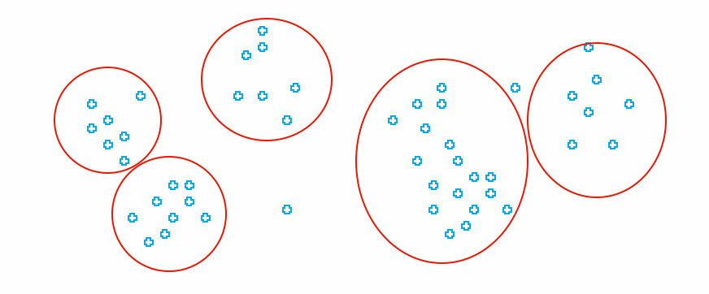
Let’s Cluster
Depot 1
Depot 5
Depot 2
Depot 3
Depot 6

Slide 16

Approach :
Initial Population
Step 1:For every depot
Step 2:Add min number of stops in the route
Step 3:Keep adding stops one by one as long as constraints are not violated
Step 4: Form a next route by repeating above 2 steps till you expire the stops in the given cluster
Step 5:Above steps give one possible/valid solution for the given depot
Step 6: Keep this loop on for initial population size

Slide 17
Sample Solution
One Possible solution for depot 1 may look like this
Depot 1
D1 | S1 | S10 | S13 | S17 | D1
D1 | S9 | S7 | S6 | D1
D1 | S89 | S11 | D1
D1 | S15 | S5 | S8 | S63 | D1

Slide 18

Approach (contd):
Fitness function
Fitness of a route = Total Trip Time + Penalty added for every constraint violation
Fitness of a solution =Σ (Fitness of Routes)
Elite population
Top N% of the fittest population is passed on as parents for crossover, mutation functions.

Slide 19
Approach (contd):
Crossover function
Step 1:For every depot
Step 2:Randomly select 2 parent(solutions) from the elite population given depot
Step 3:Randomly select 90 to 95 % stops from the cluster of given depot
Step 4: Randomly pick 2 stops from step 2 and swap their positions in both the solution
Step 4:Repeat step 4 till you expire all stops selected by step 3
Step 5:Add the 2 new solutions in next generation population
Step 6: Keep this loop on for initial population size

Slide 20
Sample Cross Over Operation
D1 | S1 | S10 | S13 | S17 | D1
D1 | S9 | S7 | S6 | D1
D1 | S89 | S8 | D1
D1 | S15 | S5 | S11 | S63 | D1
D1 | S9 | S5 | S13 | S63 | D1
D1 | S89 | S17 | S6 | D1
D1 | S1 | S7 | D1
D1 | S10 | S15 | S8 | S11 | D1
Randomly selected set of stops
S1,S9,S89,S11
Now swap 2 stops at a time
D1 | S9 | S10 | S13 | S17 | D1
D1 | S1 | S7 | S6 | D1
D1 | S11 | S8 | D1
D1 | S15 | S5 | S89 | S63 | D1
D1 | S1 | S5 | S13 | S63 | D1
D1 | S11 | S17 | S6 | D1
D1 | S9 | S7 | D1
D1 | S10 | S15 | S8 | S89 | D1

Slide 21
Approach (contd):
Mutation function
Step 1:For every depot
Step 2:Randomly select a parent from the elite population given depot
Step 3:Swap first and last stop of every route in the solution
Step 4:Add the new solution in next generation population
D1 | S1 | S10 | S13 | S17 | D1
D1 | S9 | S7 | S6 | D1
D1 | S89 | S8 | D1
D1 | S15 | S5 | S11 | S63 | D1
D1 | S17 | S10 | S13 | S1 | D1
D1 | S6 | S7 | S9 | D1
D1 | S8 | S89 | D1
D1 | S63 | S5 | S11 | S15 | D1

Slide 22
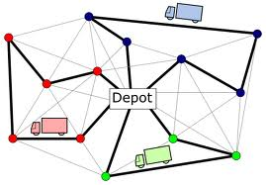
Output
D1 | S1 | S10 | S13 | S17 | D1
D1 | S9 | S7 | S6 | D1
D1 | S89 | S8 | D1
D1 | S15 | S5 | S11 | S63 | D1
D2 | S19 | S25 | S43 | S93 | D2
D2 | S29 | S67 | S65 | D2
D2 | S19 | S71 | D2
D2 | S3 | S85 | S29 | S14 | D2
And so on …for all the depots

Slide 23
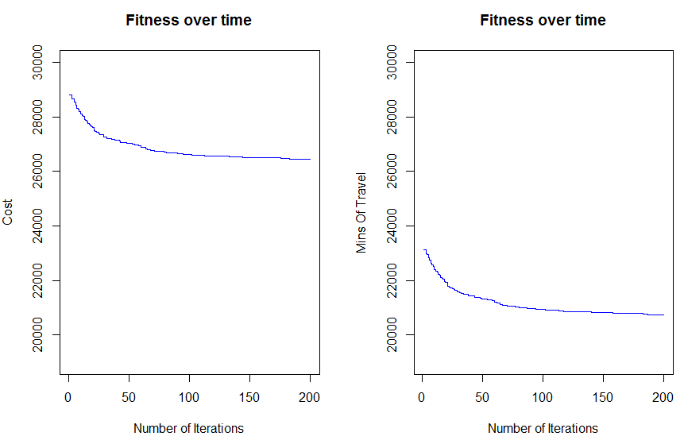
Output

Slide 24

Business Value
Iteration 1
Cost =28817.28
Mins of Travel =23117.28
No of routes=57
Iteration 200
Cost =26440.72
Mins of Travel =20740.72
No of routes=56
Saved Mins of Travel=2300$ Per Day
Cost=2300$ Per Day
Note :All our initial solutions are constrained to follow the business constraints and penalized whenever it doesn't. By using heuristic approach we arrived at the set of routes which takes least mins of travel time and cost

Slide 25
Future Scope
Stop Level Clustering
Customer Value Rating
More Random Solutions for depots with higher workload

Slide 26
Q & A
-Thank You

